Slide 1
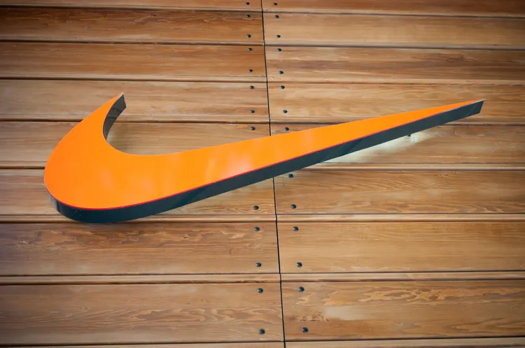
NIKE
SHOPPING
SITE
(user interface testing)

Slide 2
About Nike.
NIKE.COM is an online Clothing and Shoe’s website .
It is a popular sports brand and used by various Athlete’s among various sports.
Feature’s to be Tested.
Sign –Up.
Login.
Wish List.
Cart.

Slide 3
TIME TAKEN
Srs Document- Day 1.
Test plan - Day 2.
Test Scenarios and Test Cases in Excel-Day 3.
Adding Test Cases to Jira and Execution and Reporting.

